Slide 1
Generating Depth Map for EPIs
“EPI-Neighborhood Distribution Based Light Field Depth Estimation” - IEEE, Junke Li,Xin Jin
GROUP 3
Giovanni Cornejo Jiayi Zhao Pawin Ruangkanit Cecilia Campisi
Notes:
“Hi everyone, we’re Group 3, and our project is about generating depth maps from Epipolar Plane Images”

Slide 2
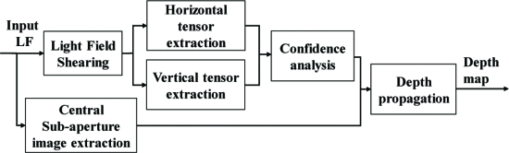
Motivation / New Idea
The paper proposes a new method to estimate depth from light-field images using Epipolar Plane Images (EPIs)
Unlike traditional methods that rely only on EPI line slopes, this method analyzes pixel intensity patterns using EPI-neighborhood distribution
This improves depth estimation robustness in low-texture and noisy regions
Framework Implemented:
Notes:
In general, depth from EPIs is generated by looking at the slanted lines formed by each scene point across different views. Methods only look at line slopes which fails when there’s low texture or noise since it breaks up the lines and there will be no clear slope to measure. The paper improved on this problem by analyzing EPI neighborhood pixel intensity patterns. This is done through this full framework: we shear the light field, extract horizontal and vertical tensors, run confidence analysis, and then propagate those results to generate the final depth map.

Slide 3
Project Goals
Reproduce the paper's results: Implement Complete Framework of the Algorithm
Compare our results to other methods via HCI 4D datasets
Expand on EPIs generated in Lab 4 by using our algorithm to produce depth map
Notes:
The goals of our project was to recreate the paper’s full framework and compare our depth maps to other methods using the HCI 4D datasets.

Slide 4
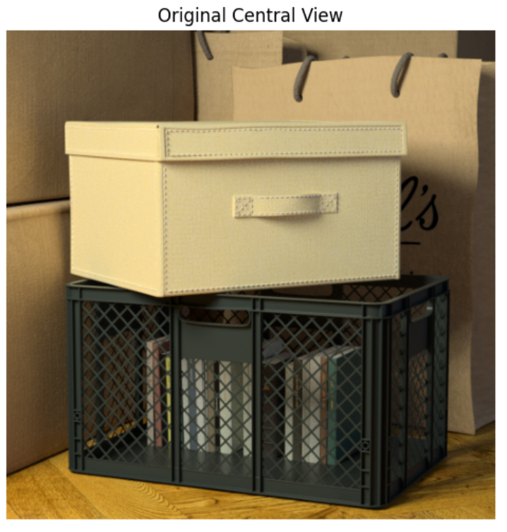
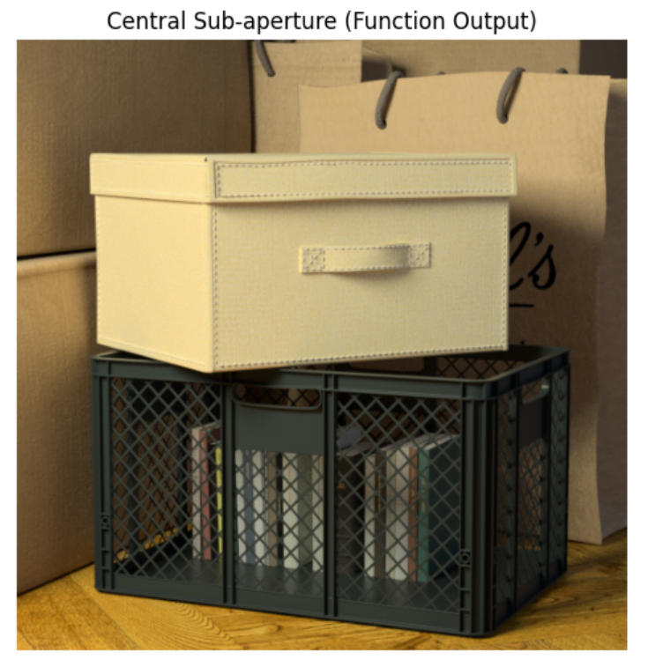
1.Input Light Field and Central sub-aperture extraction
We extract the central view of the light field programmatically
•This allows us to verify the input and use the central image later for depth propagation
•The extracted central view matches the original central image from the raw light field
Central Sub-aperture shape (Expected H, W, C): (512, 512, 3)

Slide 5
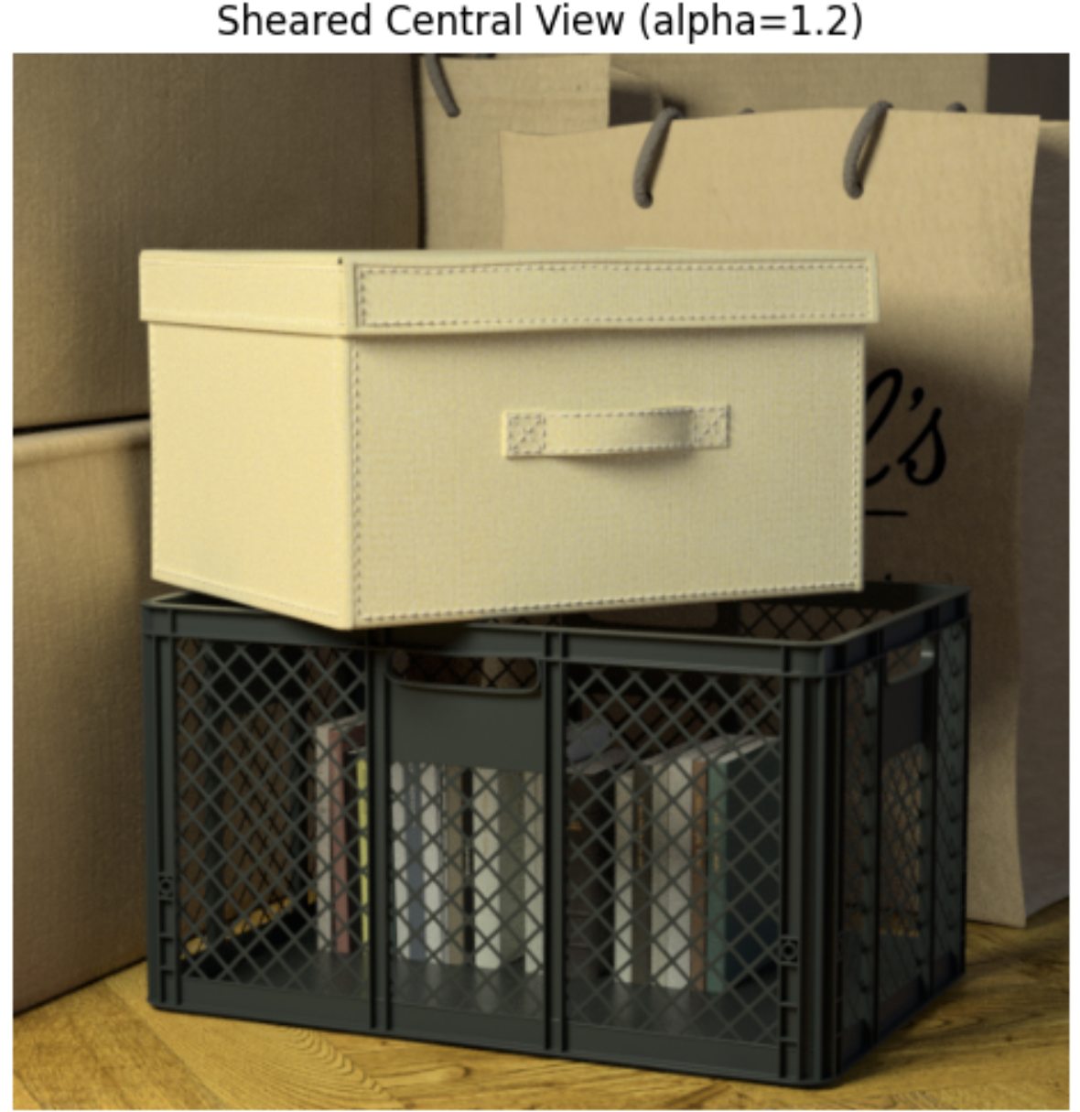
2.Light-Field Shearing
We apply an angular shear to the light field using parameter α
•Shearing simulates refocusing the scene at different depth levels
•When α matches the true depth, EPI lines become vertical (no disparity)
•The sheared light field keeps the same shape (H, W, U, V, C)
•Sheared EPIs are later used to compute depth tensors
Sheared LF shape: (512, 512, 9, 9, 3)

Slide 6
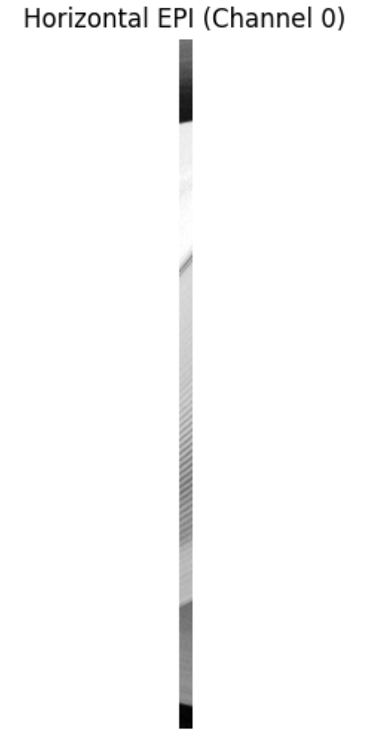
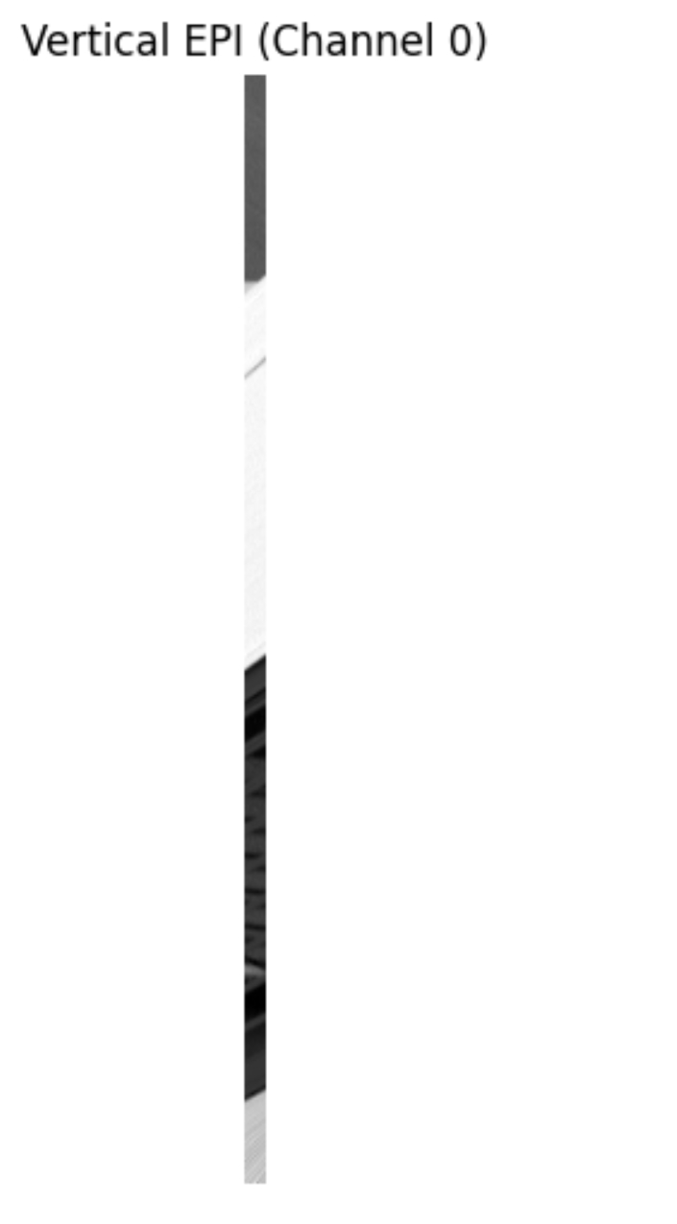
3.Tensor extraction
We grab a single horizontal EPI (x–u) and vertical EPI (y–v) using
extract_horizontal_epi → shape (W, U, C)
extract_vertical_epi → shape (H, V, C)
Then we build the full EPI stacks:
One horizontal EPI for every row → total H EPIs
One vertical EPI for every column → total W EPIs
These EPIs get passed into our tensor code, where each pixel’s local window is split into left and right sides and we compute KLD between their intensity histograms.
Single EPI Extraction
Notes:
Split each pixel local window and computer the KLD between intensity histograms

Slide 7
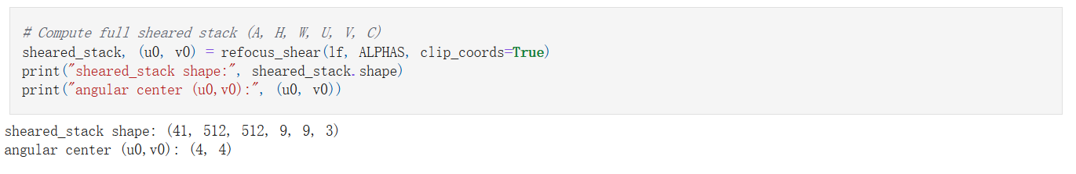
4.Refocused Stack Over Many Alphas (Depth Labels)
• We refocus the light field using a set of α values
• Each α produces a sheared light-field aligned to a different depth
• This gives us an (A, H, W, U, V, C) stack
• These sheared light-fields are used to compute KLD tensors

Slide 8
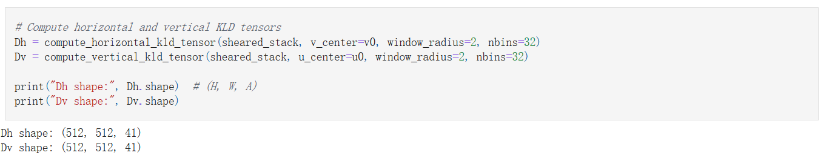
5. Compute KLD Tensors
•For each alpha level, we compute how well each pixel aligns across views using symmetric KLD.
•We use a small local window (radius = 2) and compare left/right or top/bottom histograms.
•This gives two tensors: Dh (horizontal): shape 512 × 512 × 41
Dv (vertical): shape 512 × 512 × 41
•Higher KLD = better depth alignment.

Slide 9
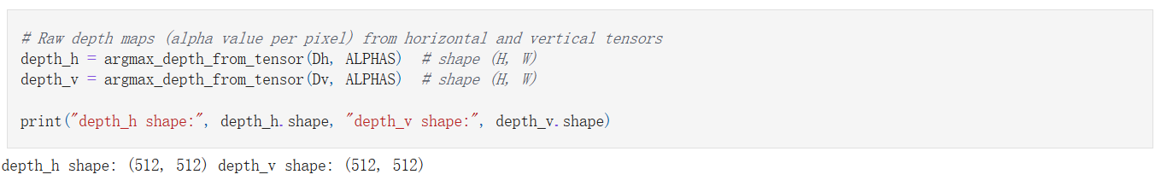
6. Convert Tensors to Raw Depth Maps
• For each pixel, find the α where Dh (or Dv) is maximized
• Produces raw horizontal depth map (depth_h)
• And raw vertical depth map (depth_v)
• These maps still contain noise & discontinuities

Slide 10
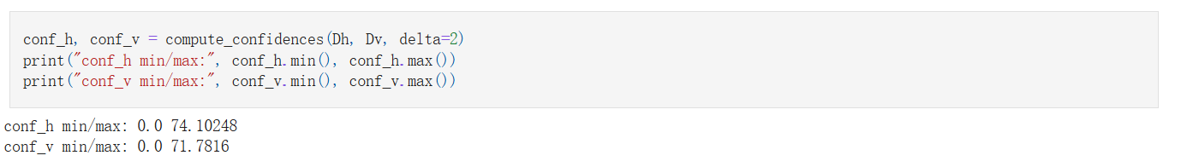
7. Compute Confidences for Horizontal and Vertical Tensors
We convert the KLD tensors into confidence maps for horizontal and vertical depth.
High confidence = the KLD peak is sharp and reliable.

Slide 11
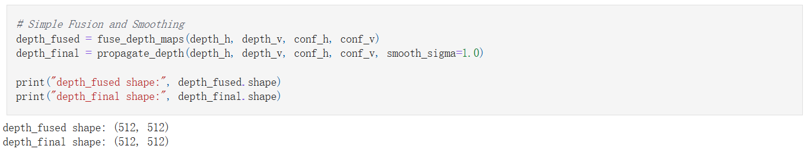
8. Fuse and Propagate to Final Depth Map
• Combine depth_h and depth_v using confidence weights
• High confidence direction dominates the fusion
• Produces an initial fused depth map before propagation

Slide 12
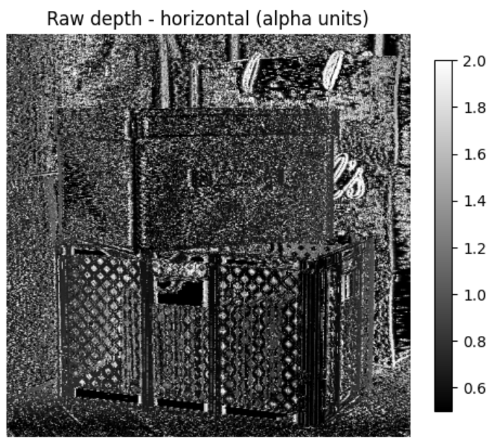
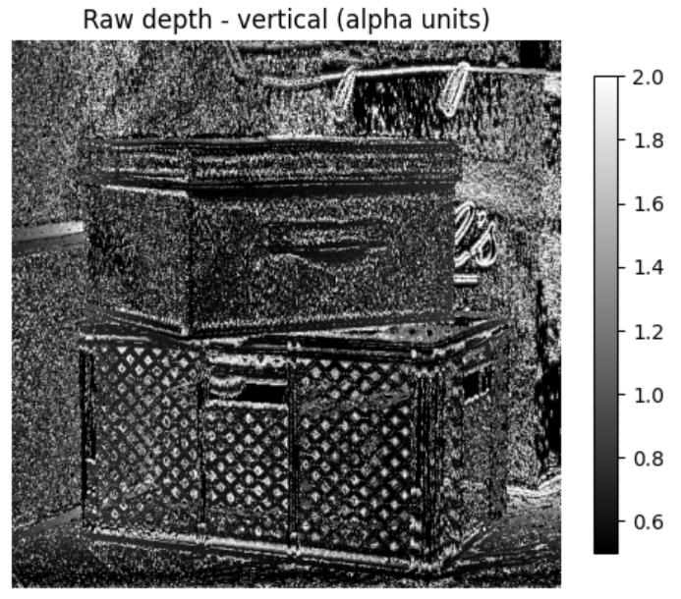
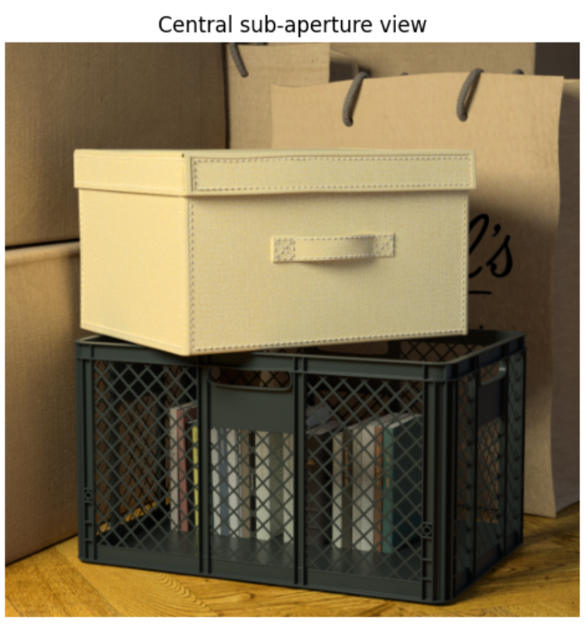
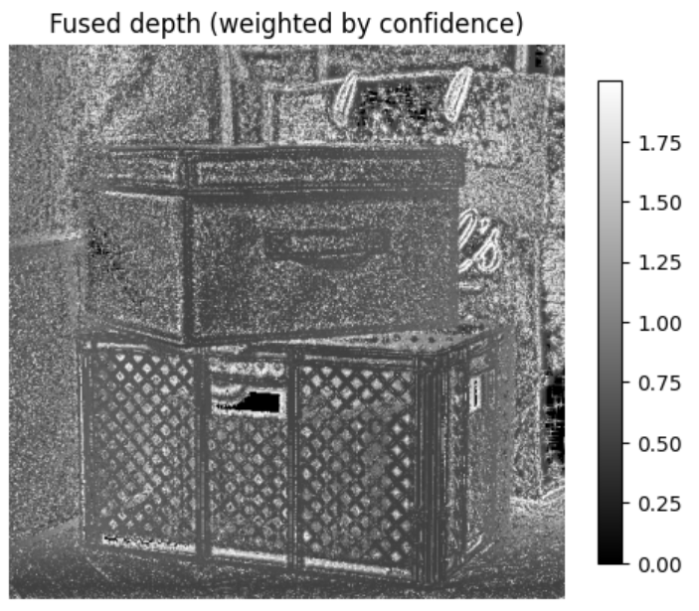
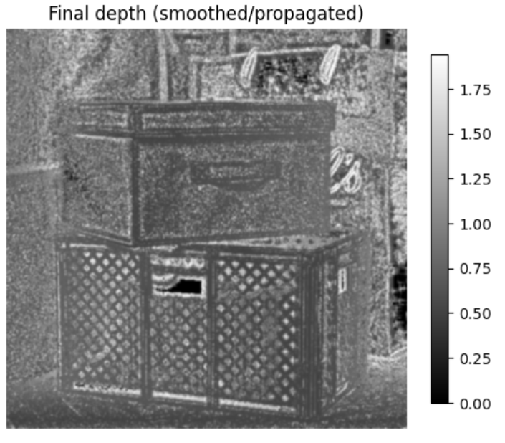
Visualize Results

Slide 13
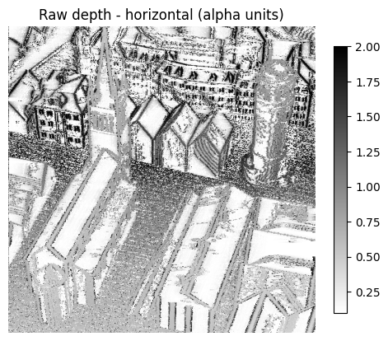
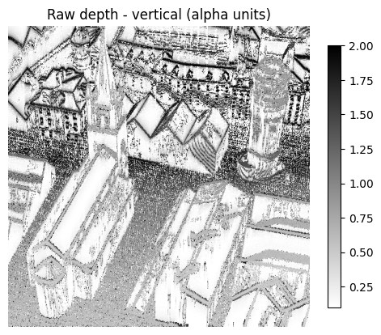
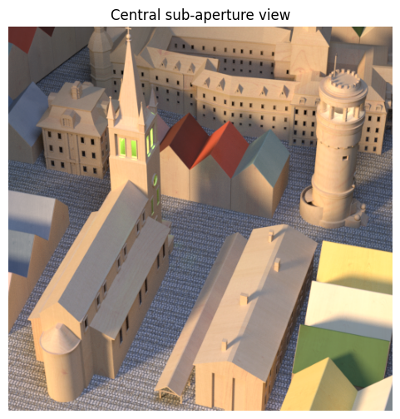
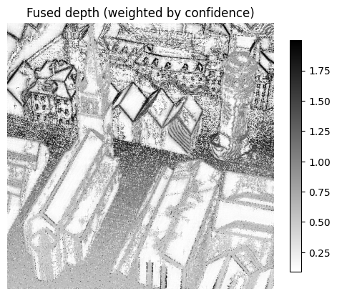
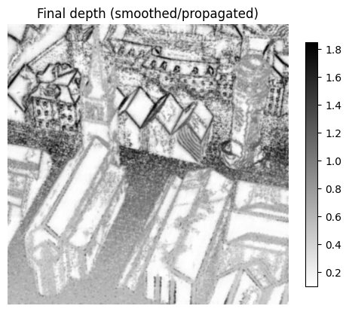
Visualize Results

Slide 14
Conclusions
Implemented the full depth-estimation pipeline from the paper.
Advantages
Effective depth extraction from EPIs
Directionally robust
Modular and interpretable
Disadvantages
Computationally expensive
High memory usage
Difficult to replicate without a camera array
Future Work
Optimize and parallelize the KLD pipeline
Experiment with learning parameter tuning

Slide 15
Questions
Notes:
“Hi everyone, we’re Group 3, and today we’ll be presenting our project on generating depth maps from Epipolar Plane Images, based on the paper EPI-Neighborhood Distribution Based Light Field Depth Estimation

